Slide 1

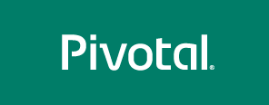
Cloud Foundry
Value Proposition
Chris Phillipson
Sr. Platform Architect
Q2’ 2017

Slide 2
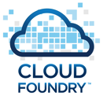
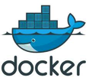
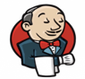
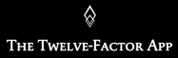


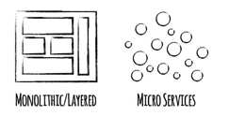

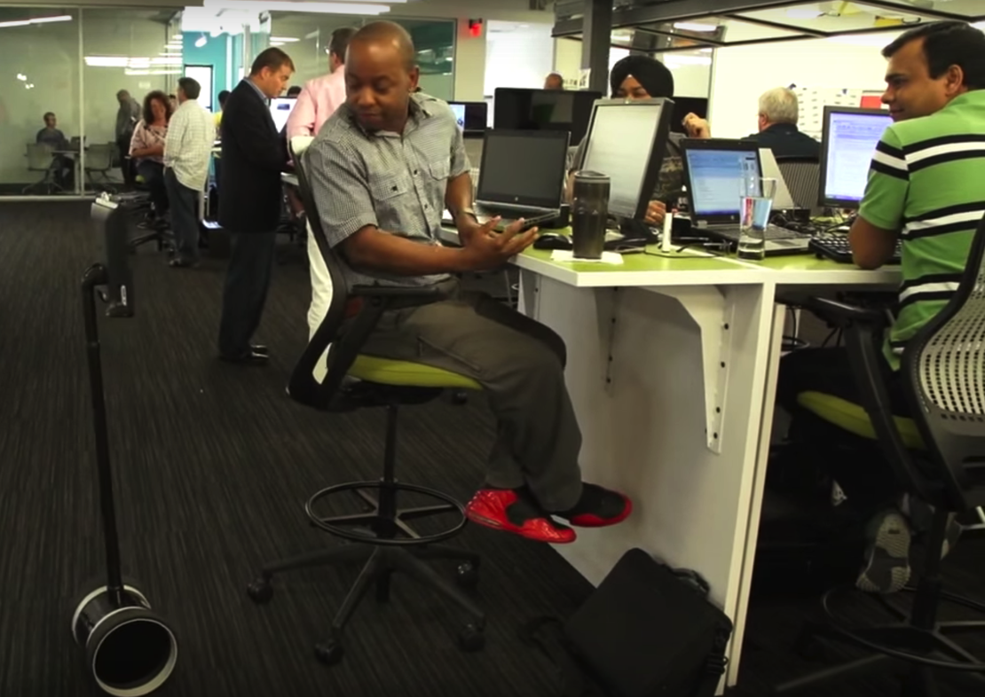
The Three Eras of IT
SOFTWARE
HAS BEEN REDEFINED
IT Era
Mainframe
Automation of Accounting
PC / Web
Automation of Paper Processes
Cloud / Mobile / IoT
Consumer / Social Apps
New Systems of Engagement
Internet of Things
Cloud-scale Computing
Data Driven Analytics
1960
1980
2005
Primary Usage
Transactions
Interactions
Cheap Smart Mobile Devices
µProcessor & PC: Cheap CPU cycles
Cheap Ubiquitous Connectivity
Enabling Factors
Cheap Cloud Computing
Cheap Storage
Existing Systems necessary, but no longer differentiating = reduce cost
New Systems where value comes from differentiating = new capabilities

Slide 3
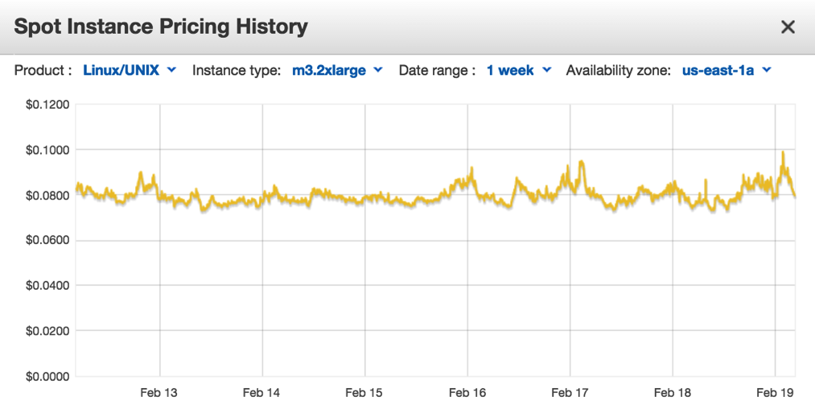

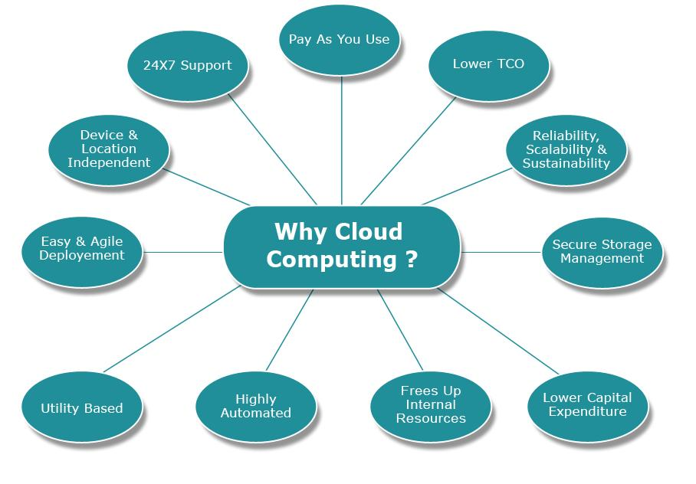
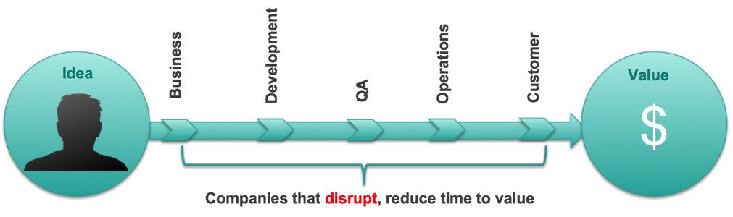
< $2 for 24hrs
"Cloud is about how you do computing, not where you do computing"
8 vCPUs 30GB RAM
2x 80GB SSD
High Network Performance
Paul Maritz,
Executive Chairman of the Board
Pivotal

Slide 4
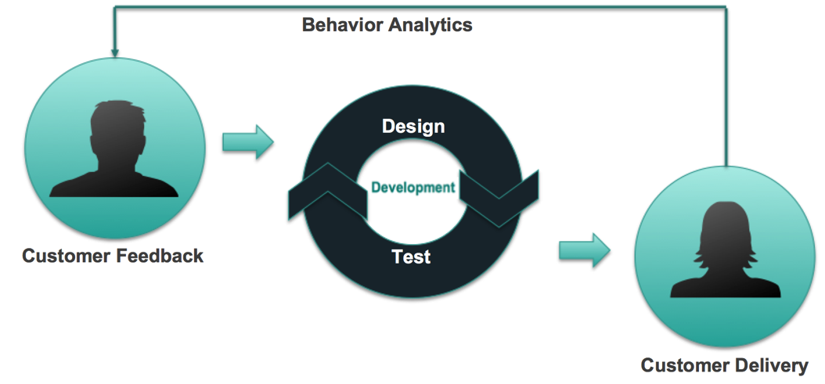
< $2 for 24hrs
"Cloud is about how you do computing, not where you do computing"
8 vCPUs 30GB RAM
2x 80GB SSD
High Network Performance
Paul Maritz,
Executive Chairman of the Board
Pivotal
Enabling Continuous Delivery
Disrupt

Slide 5

Waterfall Project/Organization
Product Mgr.
Dev
UX
QA
DBA
Cloud Native
Platform
Biz Capability Team & µServices
Product Mgr.
Dev
UX
QA
DBA
System
Admin
Network
Admin
Storage
Admin
Product Mgr.
Dev
UX
QA
DBA
Self-Service
APIs
System
Admin
Network
Admin
Storage
Admin
Biz Capability Team & µServices
Product Team Using Monolithic Delivery
Platform Ops Team
Product Mgr.
Different Organizational Silos
Communicating via Support Tickets
and Work Orders
Dev
UX
QA
DBA
DevOps
Biz Capability Team & µServices
Enabling Continuous Delivery
Disrupt

Slide 6
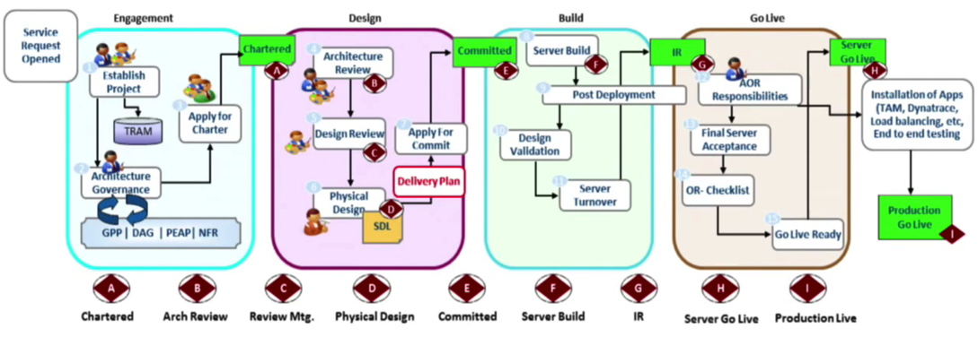
Waterfall Project/Organization
Product Mgr.
Dev
UX
QA
DBA
Cloud Native
Platform
http://tinyurl.com/KeyNoteAllstate
Biz Capability Team & µServices
Product Mgr.
Dev
UX
QA
DBA
System
Admin
Network
Admin
Storage
Admin
Product Mgr.
Dev
UX
QA
DBA
Self-Service
APIs
System
Admin
Network
Admin
Storage
Admin
Biz Capability Team & µServices
Product Team Using Monolithic Delivery
Platform Ops Team
Product Mgr.
Different Organizational Silos
Communicating via Support Tickets
and Work Orders
Dev
UX
QA
DBA
DevOps
Biz Capability Team & µServices
Enabling Continuous Delivery
Disrupt

Slide 7
Waterfall Project/Organization
Product Mgr.
Dev
UX
QA
DBA
Cloud Native
Platform
http://tinyurl.com/KeyNoteAllstate
Biz Capability Team & µServices
Product Mgr.
Dev
UX
QA
DBA
System
Admin
Network
Admin
Storage
Admin
Product Mgr.
Dev
UX
QA
DBA
Self-Service
APIs
System
Admin
Network
Admin
Storage
Admin
Biz Capability Team & µServices
Product Team Using Monolithic Delivery
Platform Ops Team
Product Mgr.
Different Organizational Silos
Communicating via Support Tickets
and Work Orders
Dev
UX
QA
DBA
DevOps
Biz Capability Team & µServices
CI/CD - Continuous Integration / Continuous Delivery Tooling
TDD - Test (1st) Driven Development w/ Automation
BDD - Business Driven Development
2PT - Two Pizza Team (size of team)
XP - Extreme Programming delivering Products (not Projects)
Paired Programming - two cockpits, one airplane
Collocation of Team - face to face interactions
Full Stack Team - Team empowered to make decisions and capable of dealing with UX, UI, DB, App Code, etc…
Microservices Architecture - Domain Driven Design
REST APIs - Cloud Native Design (12-Factor Apps)
Refactoring & Introspection - constant revision/ improvement
MVP - Minimum Viable Product
New Vocabulary
Disrupt

Slide 8
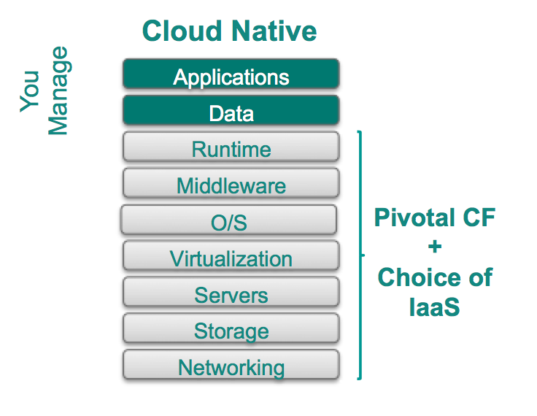

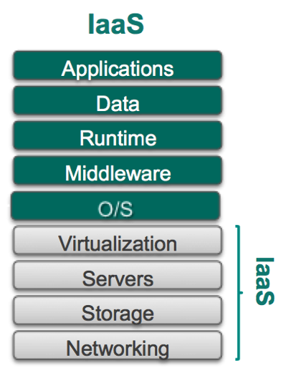
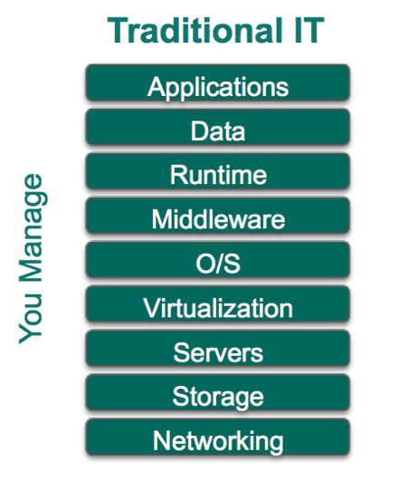



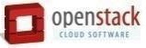

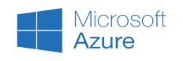
Waterfall Project/Organization
Product Mgr.
Dev
UX
QA
DBA
Cloud Native
Platform
http://tinyurl.com/KeyNoteAllstate
Biz Capability Team & µServices
Product Mgr.
Dev
UX
QA
DBA
System
Admin
Network
Admin
Storage
Admin
Product Mgr.
Dev
UX
QA
DBA
Self-Service
APIs
System
Admin
Network
Admin
Storage
Admin
Biz Capability Team & µServices
Product Team Using Monolithic Delivery
Platform Ops Team
Product Mgr.
Different Organizational Silos
Communicating via Support Tickets
and Work Orders
Dev
UX
QA
DBA
DevOps
Biz Capability Team & µServices
- On-Premise
- Off-Premise
- Pivotal Web Services
- Managed Services
PaaS

Slide 9
Waterfall Project/Organization
Product Mgr.
Dev
UX
QA
DBA
Cloud Native
Platform
http://tinyurl.com/KeyNoteAllstate
Biz Capability Team & µServices
Product Mgr.
Dev
UX
QA
DBA
System
Admin
Network
Admin
Storage
Admin
Product Mgr.
Dev
UX
QA
DBA
Self-Service
APIs
System
Admin
Network
Admin
Storage
Admin
Biz Capability Team & µServices
Product Team Using Monolithic Delivery
Platform Ops Team
Product Mgr.
Different Organizational Silos
Communicating via Support Tickets
and Work Orders
Dev
UX
QA
DBA
DevOps
Biz Capability Team & µServices
Let's take a look at what it takes to make this work.
- On-Premise
- Off-Premise
- Pivotal Web Services
- Managed Services

Slide 10
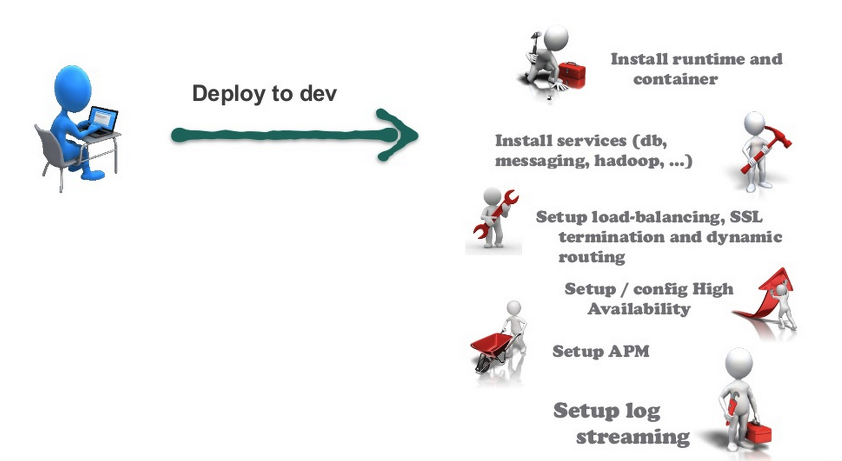
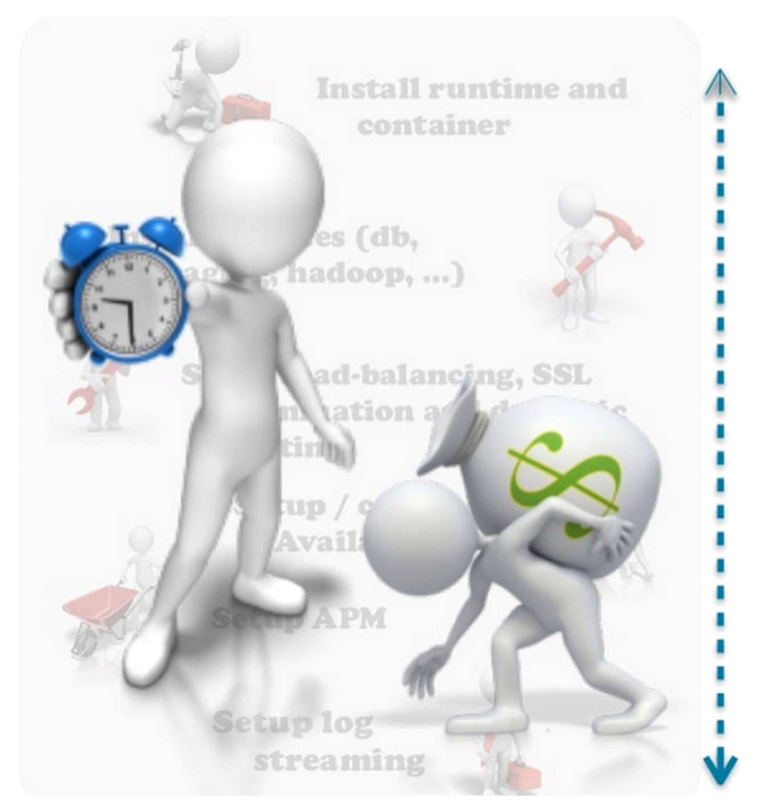
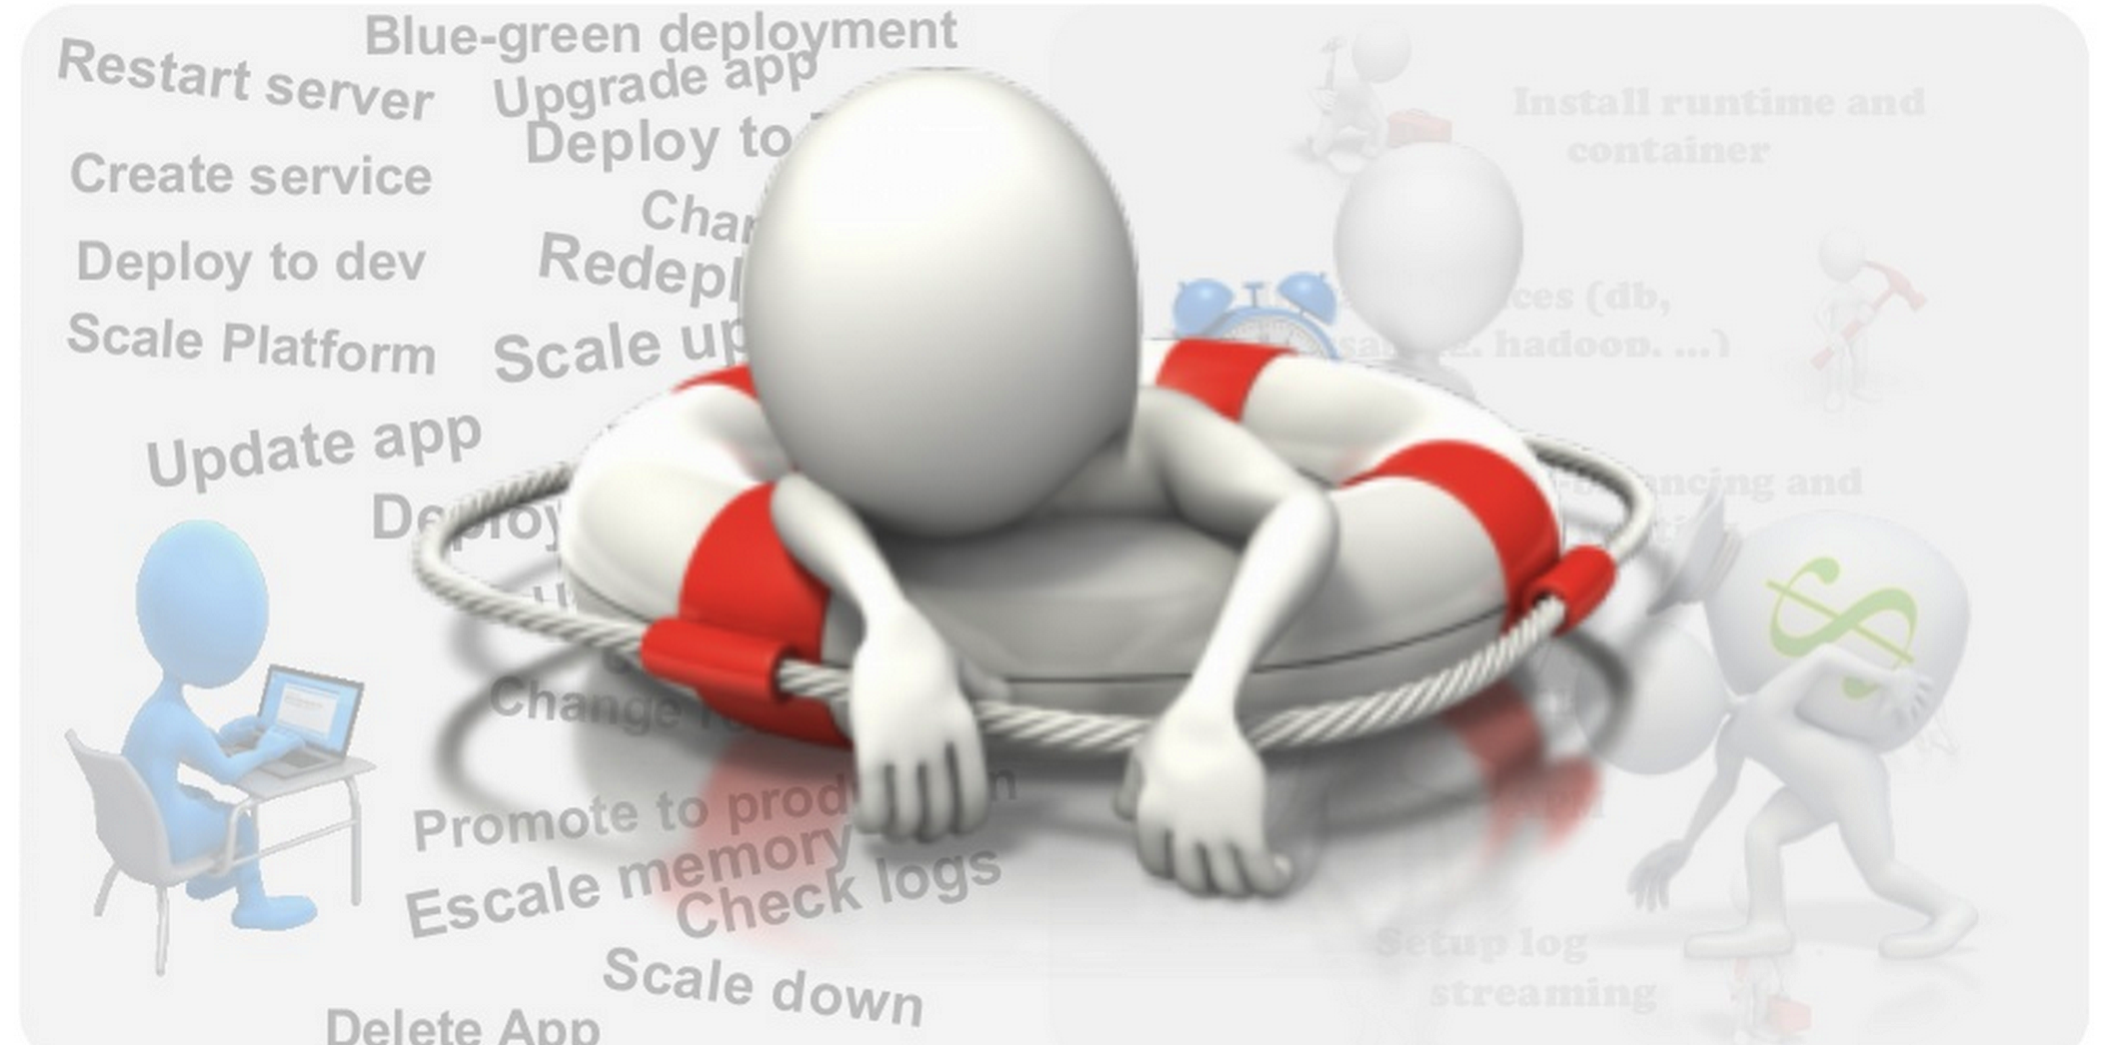
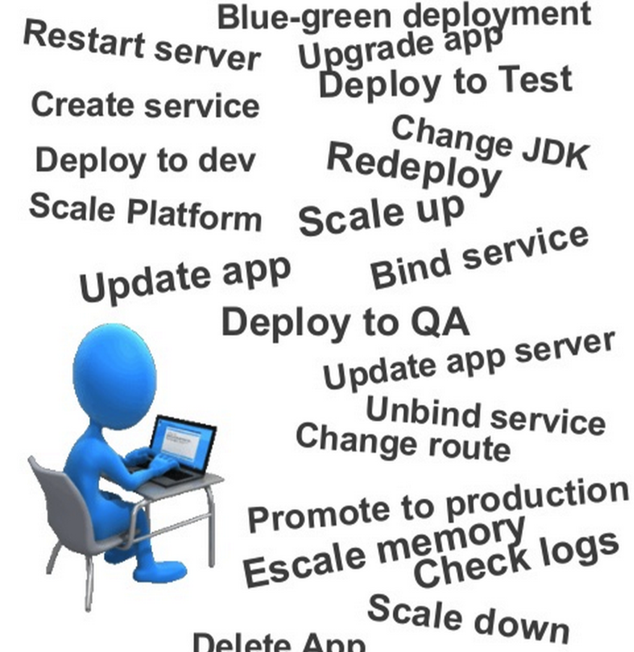
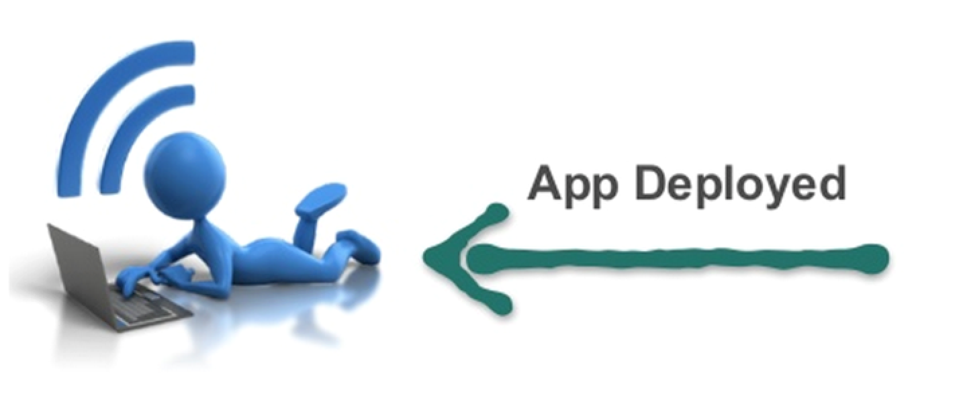
Developer
Operations

Slide 11
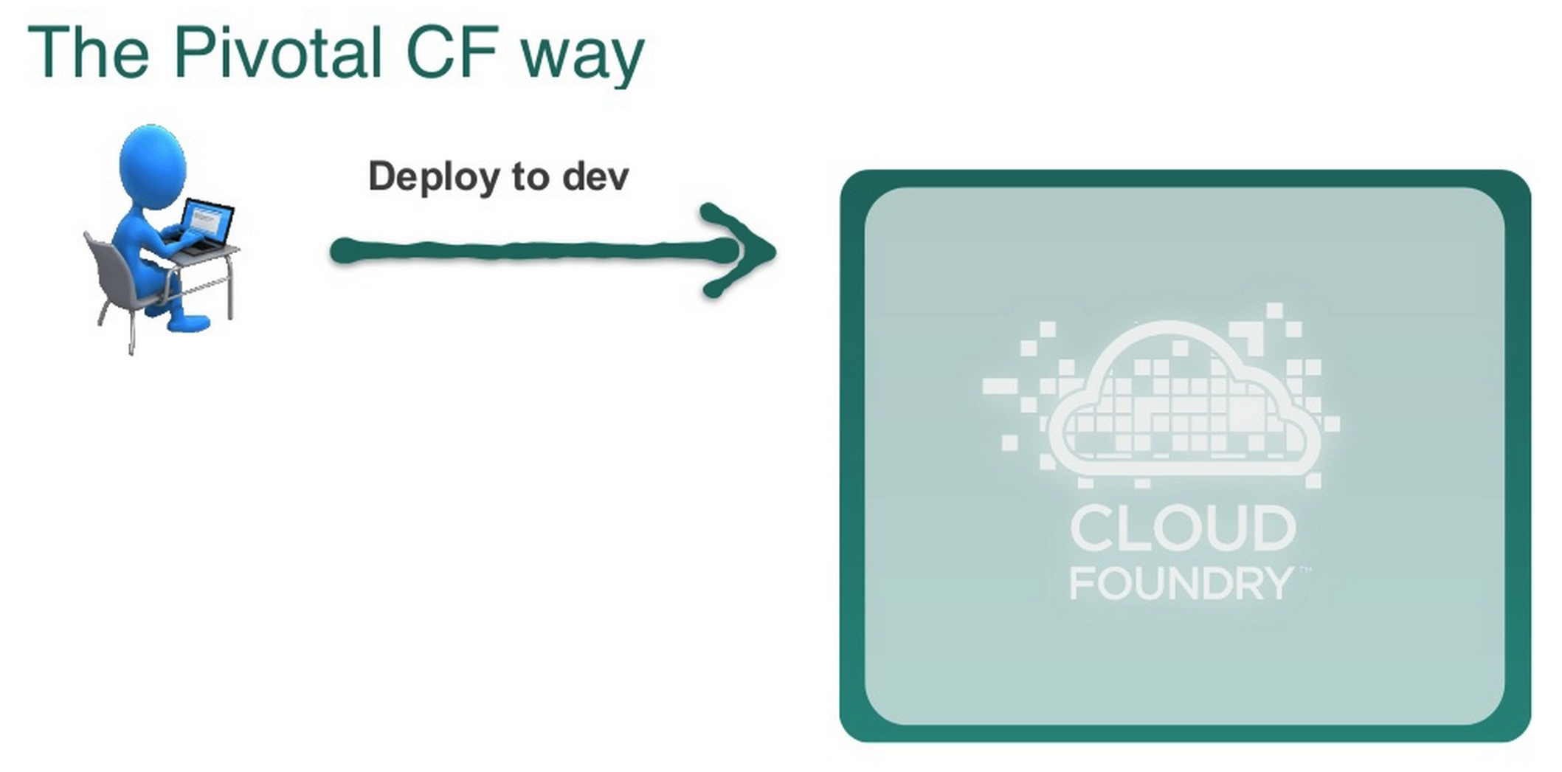
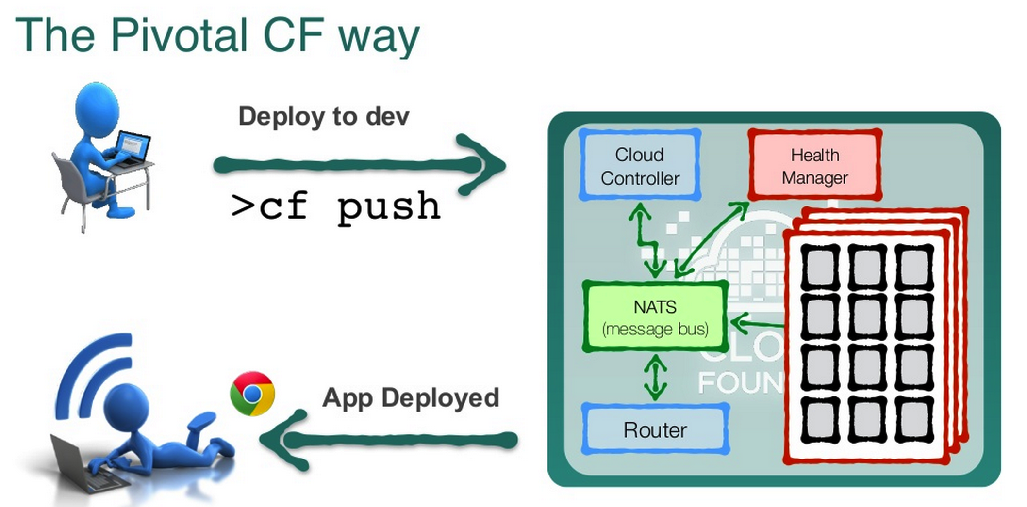
DevOps

Slide 12
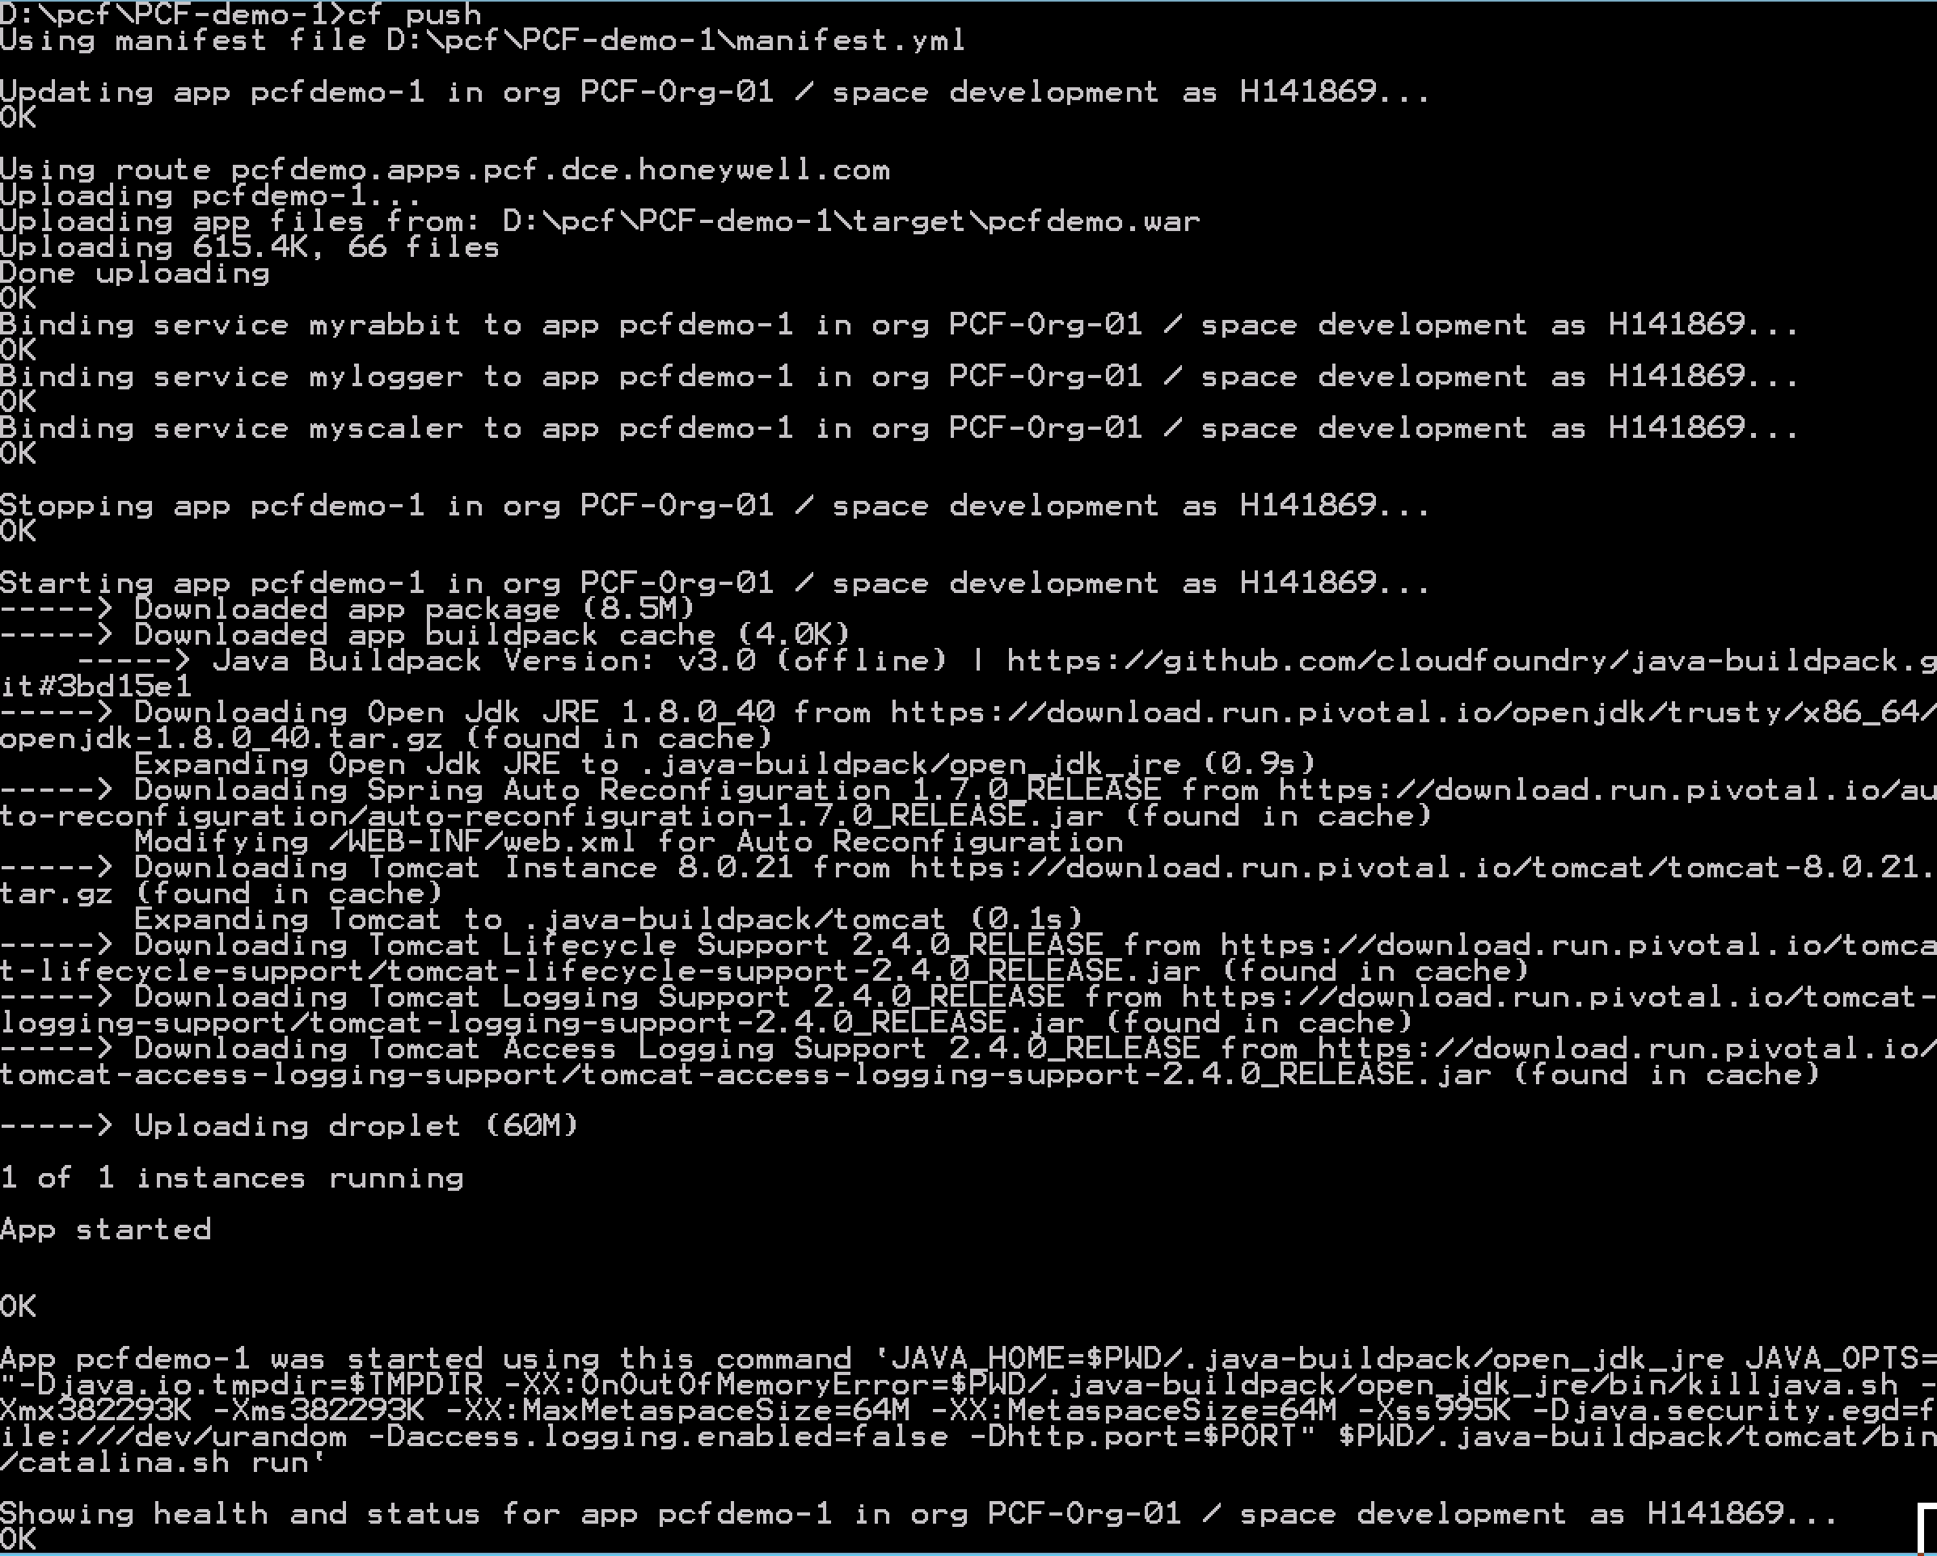
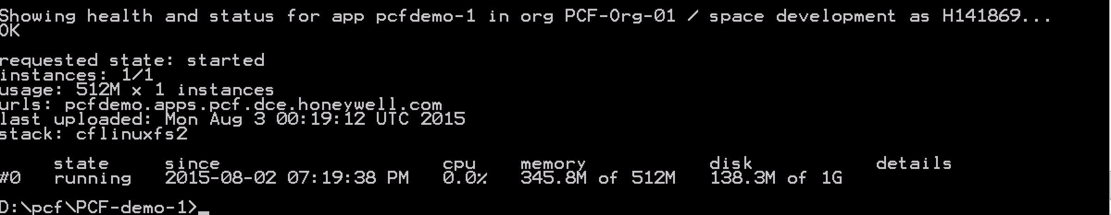
Speed, Process Conformity, Automation, Repeatability
Firewall & Routes
Service Bindings
App Lifecycle Management
Runtime Installation & Config
Middleware Installation & Config
Application Installation & Config
App Lifecycle
Logging, Health, Telemetry
Application running < 1 min.

Slide 13
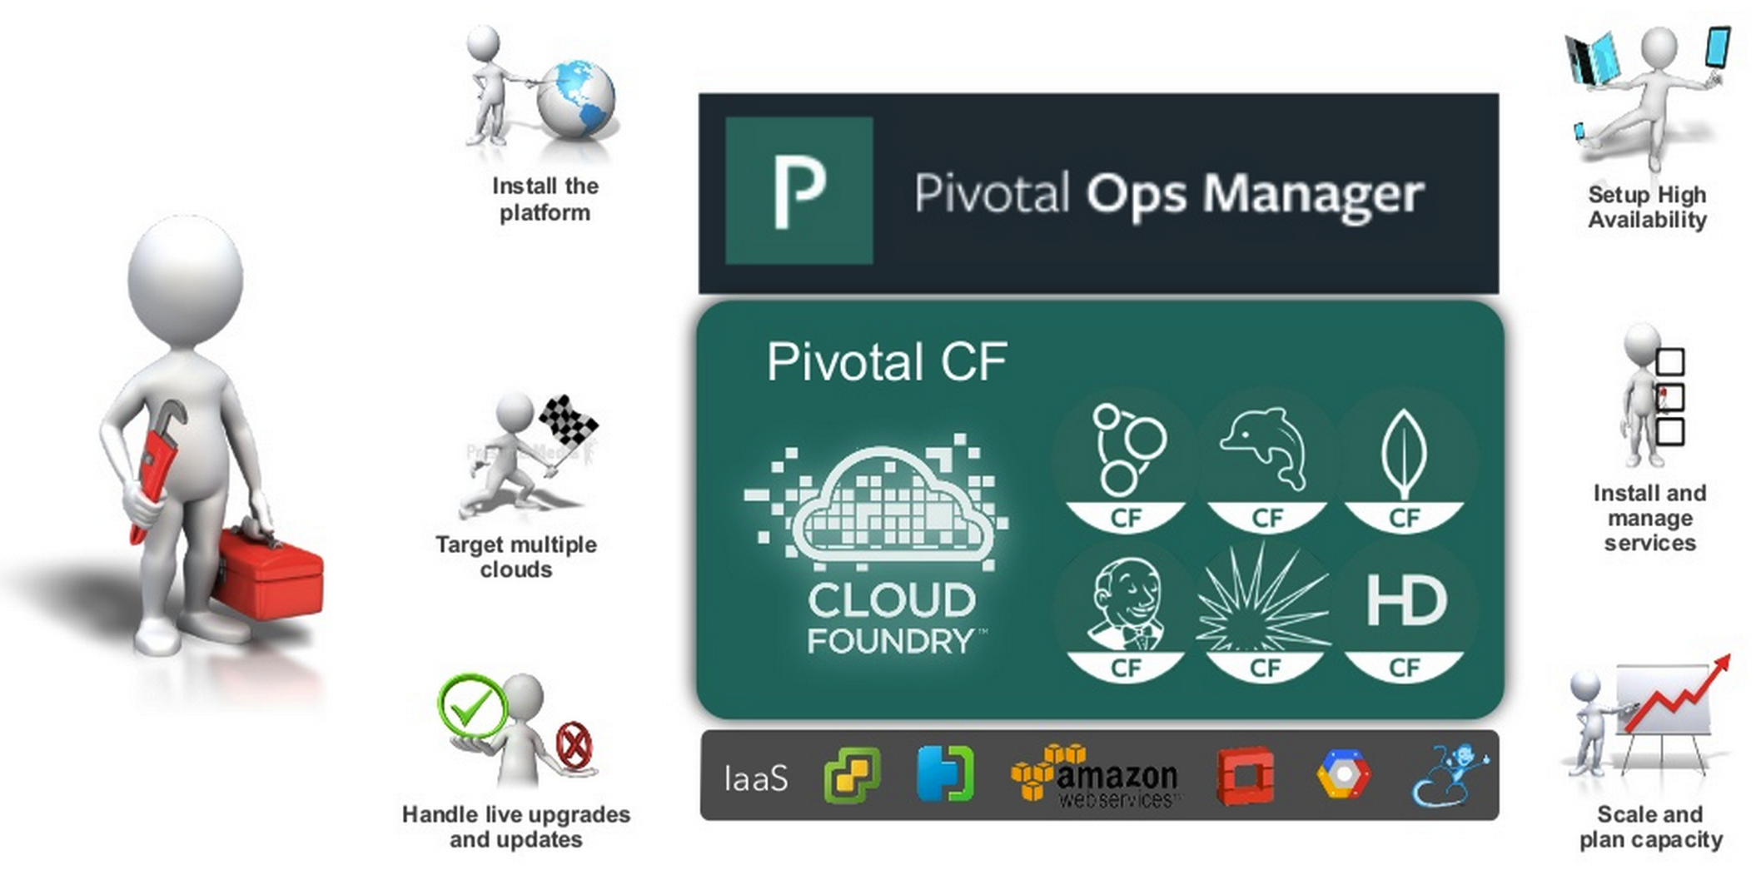
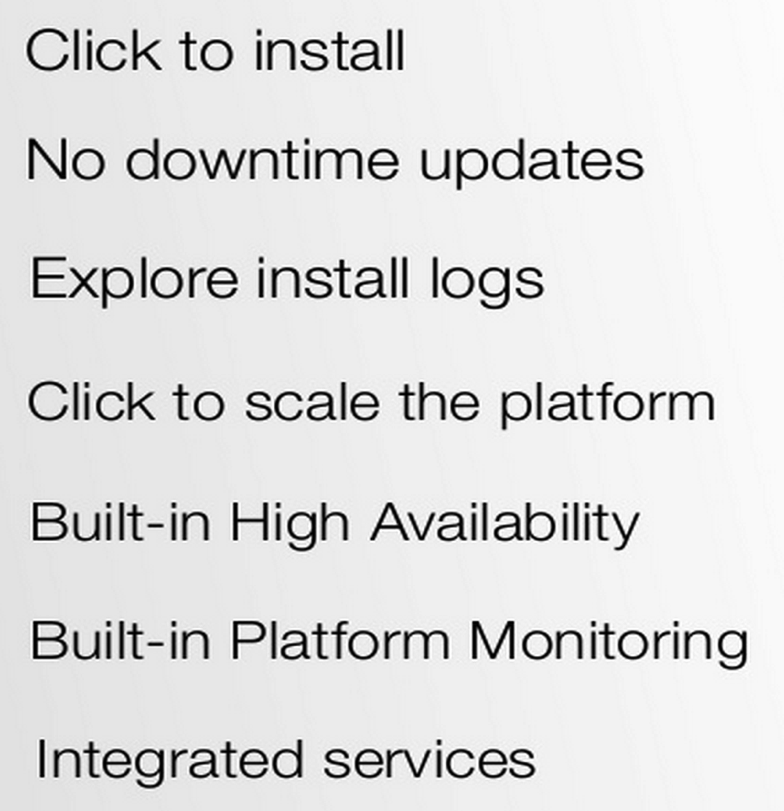
The Operator in a PaaS era
DevOps

Slide 14
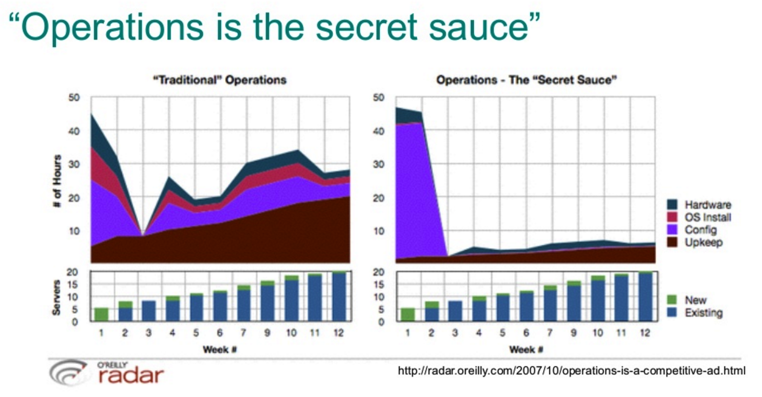
Day #2 Operations

Slide 15
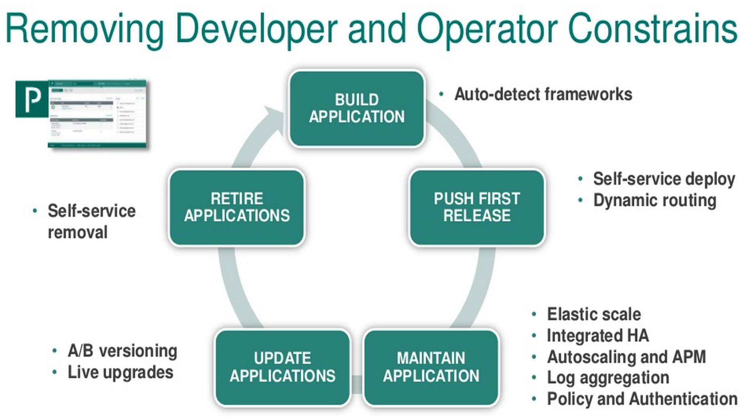
Day #2 Ops

Slide 16
Continuous Delivery
Development
CI/CD
Operations
Specify
Code
Build
Test /
Verify
Package Repository
Deploy
Production Concerns
Day 0
Day 1
Day 2
Automated
Manual
Notes:
Day 0 – Develop Code
Day 1 – Deploy Code
Day 2 – Maintain and Operate
There is an impedance mismatch – you automate the pipeline until deploy and then what?
You deploy your bits where? Do you want to spray your bits across machines…and pray? What’s next? What are the issues you can expect to encounter?
You might think your job is done after deployment…

Slide 17
"Cloud is about how you do computing, not where you do computing"
Paul Maritz,
Executive Chairman of the Board
Pivotal

Slide 18
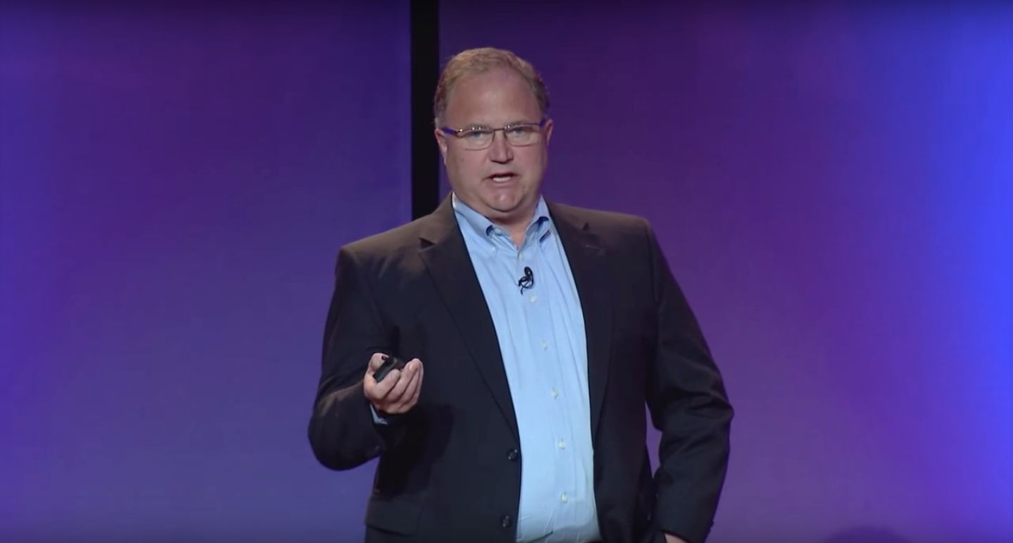
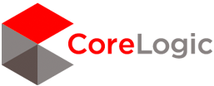

CoreLogic, Inc. is a $1.4B provider of financial, property and consumer information, analytics and business intelligence.
“Moving to a Cloud Native Platform is more than a technological transformation.
It’s a new way to develop products…It’s the most exciting thing we’ve done in the last 12 months.”
-Richard Leurig,
SVP Innovation Development Center

Slide 19
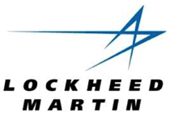
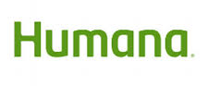
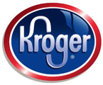

Pivotal Cloud Foundry Customer Quotes:
“App in 10 weeks instead of 9 months”
“From 2 months for provisioning servers to deliver product in less than 5 weeks”
“The lean, agile product development practice we’ve stood up in partnership with Pivotal labs is a vehicle for cultural transformation.”
“18 lines of code to get a database, messaging middleware and an app server - kind of amazing!”
“Experience really been positive. Helped us become more “T” shaped engineers”
Notes:
Pivotal is the fastest growing open source company in history.
We are getting some good results for our customers. We would love to work with you further.

Slide 20





Cloud Native Enablers
Continuous Delivery
of Containerized µServices on a Cloud Native Platform
within a Open Source & DevOps Culture
Disruptors
Microservices - Let your developers move faster by composing services designed for independent deployment, scaling and recovery.
Containers - Build applications as deployable containers then leverage distributed container scheduling to ensure the right workloads are running, and keep running.
Open Source - Built on the fully open source Cloud Foundry, backed by contributions from over 40 members of the Cloud Foundry Foundation.
Continuous Delivery - Shorten your software delivery cycle with a platform designed to cut the time and cost of managing deployment and operations.
DevOps - Align incentives and behaviors across your organization with a high trust, empowered culture and a structured platform that makes doing the right thing easy.

Slide 21



Continuous Integration and Delivery
Full application lifecycle management
Build Pipeline Operations
Commit Code Change
Automate Build & Test
(Unit Test, Static Code Analysis)
Store Binaries & Build Artifacts
Automated Integration Testing
Acceptance,Performance & Load
Zero Downtime Upgrade to Production
Tool Chain
Gitlab
Jenkins
Development
Test + UAT + Staging
Production

Slide 22
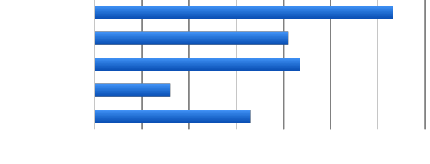
Productivity: Software developers spend too much time on administration
0
2
4
6
8
10
12
14
Design and Coding
Brainstorming
Administrative Tasks
Managing Environments
Waiting for Test/Build
Task Breakdown
Average Hours / Week
Sources: “Electric Cloud LinkedIn Survey to software developers”
Notes:
Application deployments setup is ticket-based, CI processes are
http://readwrite.com/2013/04/25/how-software-developers-really-spend-their-time

Slide 23
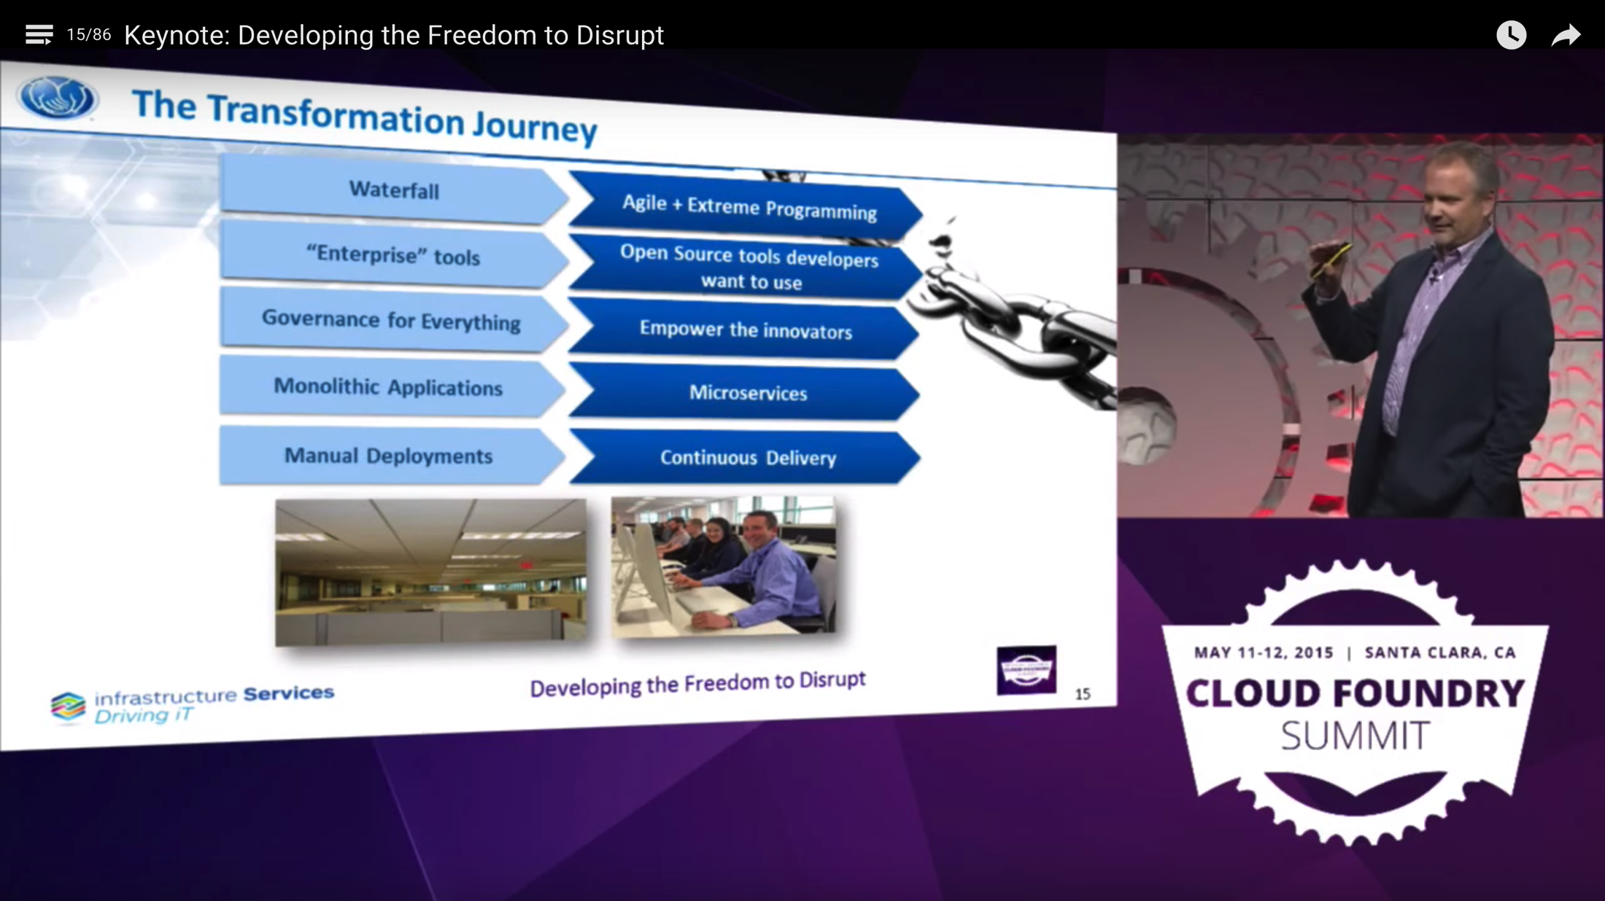
https://blog.pivotal.io/pivotal-cloud-foundry/case-studies/allstates-andy-zitney-is-disrupting-how-insurance-does-technology
Notes:
An 85 year old company – re-inventing itself…

Slide 24
Building Cloud^{(*)} Applications
Cloud Native
Microservices Architecture and Principles
API first design
Cloud Resilient
Design for failure
Apps are unaffected by dependent service failure
Proactive testing for failure
Metrics and monitoring baked in
Cloud agnostic runtime implementation
Cloud Native
Maturity Model
Cloud Friendly
Twelve Factor App
Horizontally scalable
Leverage platform for HA
Cloud Ready
No file-system requirements or uses S3 API
Self contained application
Platform managed ports and addressing
Consume off platform services using platform semantics

Slide 25




Microservice: Definition
If every service has to be updated in concert, it’s not loosely coupled!
“ Loosely coupled service oriented architecture with bounded contexts"
If you have to know about surrounding services you don’t have a bounded context.
- Adrian Cockcroft
Notes:
BV = Battery Ventures is a venture capital firm that invests in cutting-edge, category-defining businesses in markets including software and services, Web infrastructure, e-commerce, digital media and industrial technologies.

Slide 26
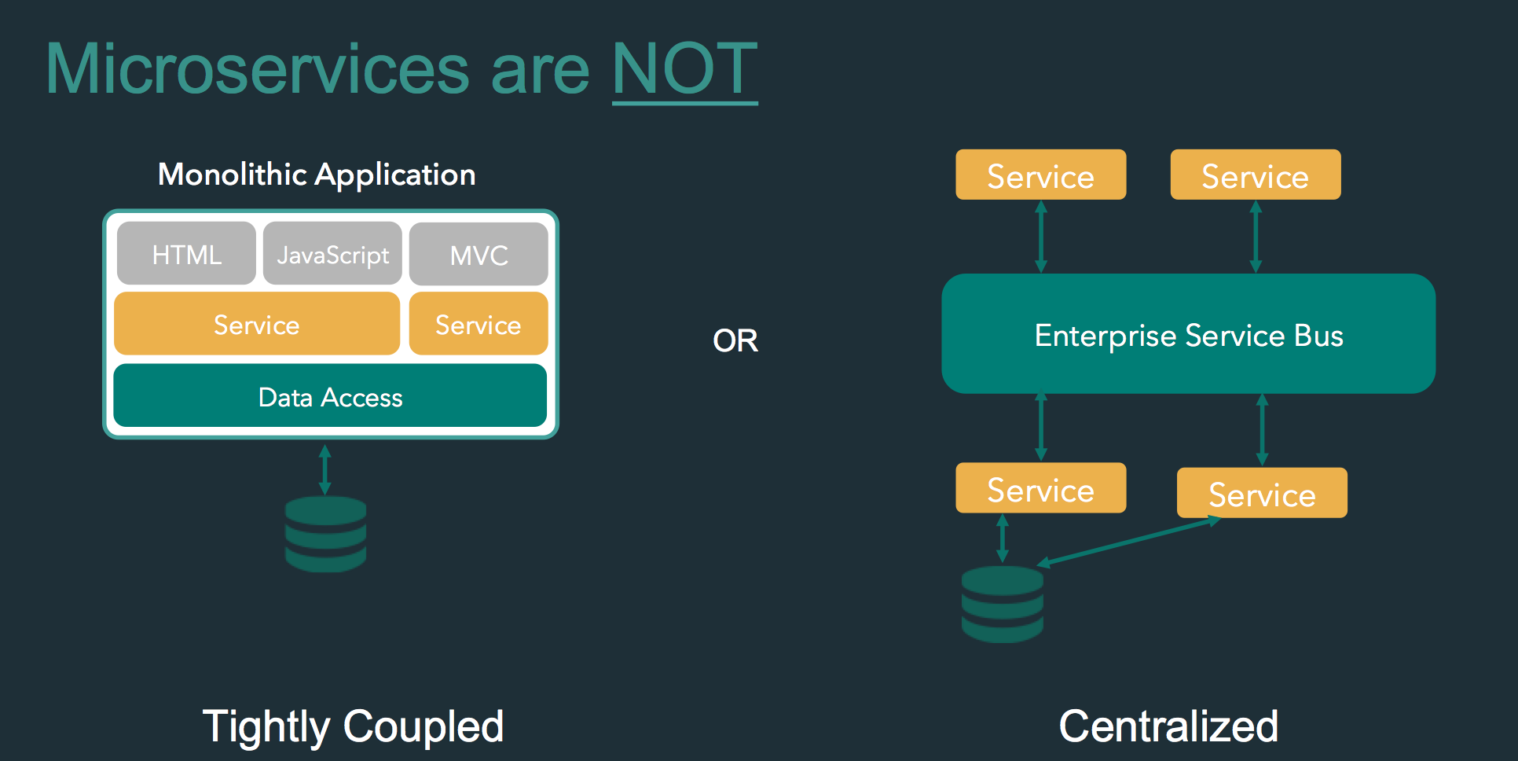

Slide 27







Microservice Architecture
Relational
DB
HTTP
HTTP
Key/Value
Store
HTTP
HTTP
HTTP
AMQP
…
AMQP
HTTP
Graph
DB
Notes:
REST and message-driven services
Polyglot persistence, services encapsulate data store semantics
Diversity of clients acknowledged
API Gateway for service aggregation, reduce chattiness, protocol translation, reduce latency/round-trips, deal with mobile device fragmentation, build use case/device specific API’s

Slide 28
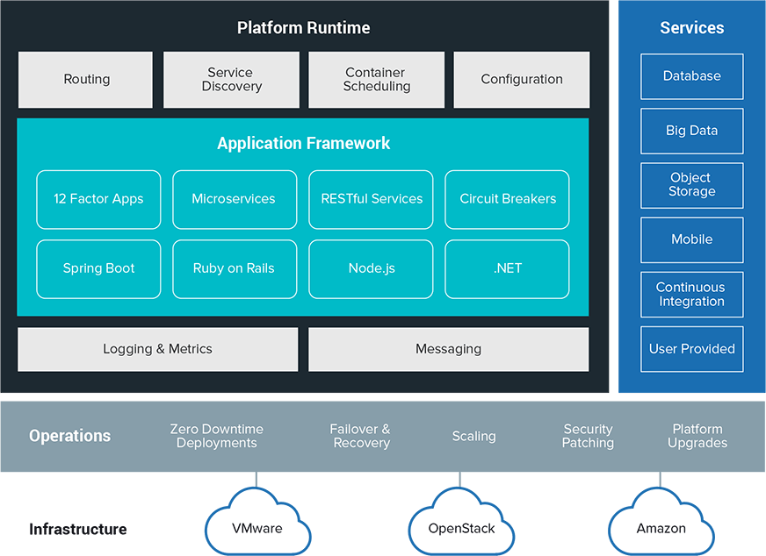
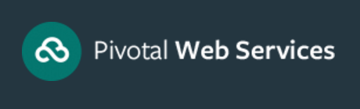
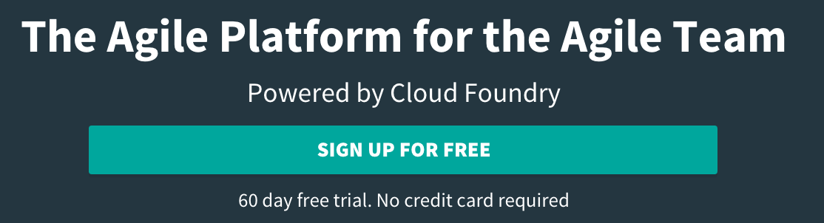


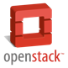
It Takes a Platform
run.pivotal.io
Infrastructure

Slide 29
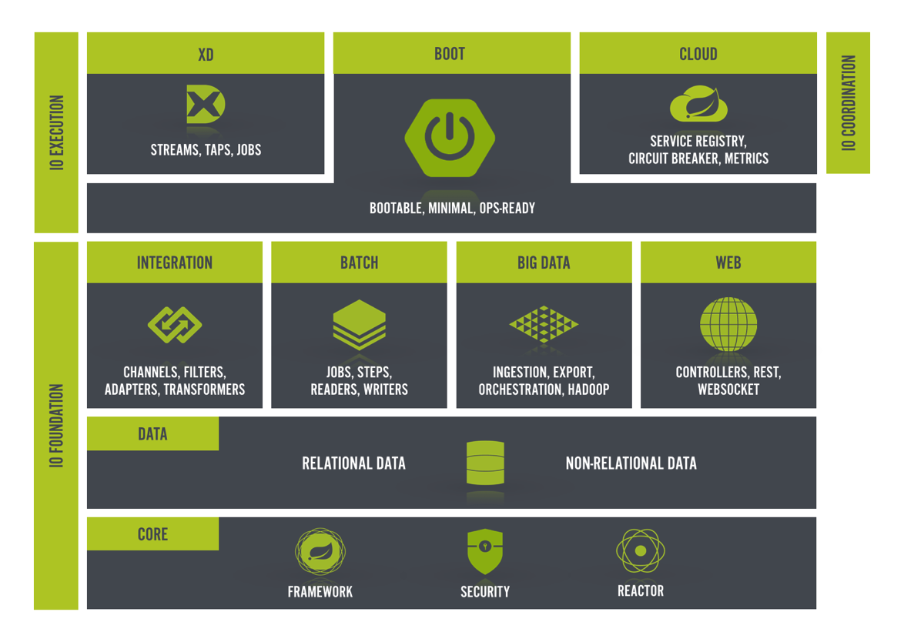
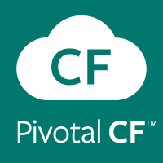
Build - http://start.spring.io
cf push
run.pivotal.io
https://start.spring.io/

Slide 30
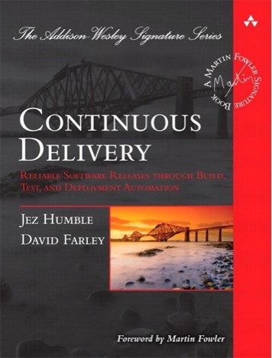
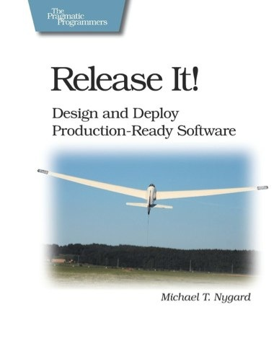
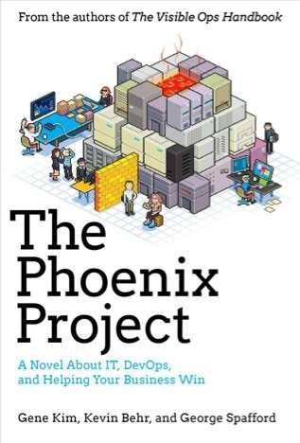
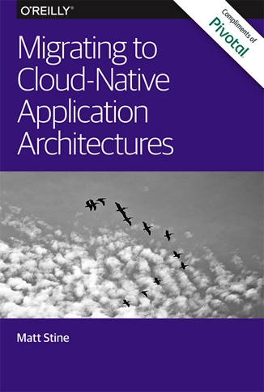
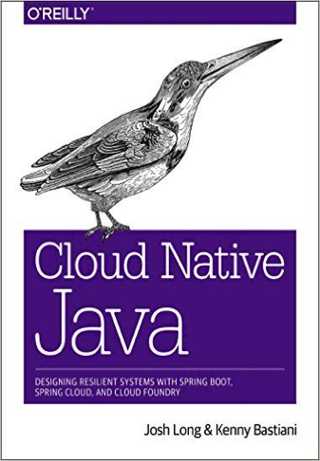
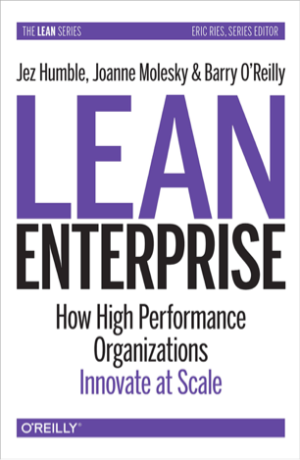


Reading
By Matt Stine (@mstine)
By Josh Long (@starbuxman)
and Kenny Bastani
Foundations

Slide 31







Anatomy of a Cloud Native Platform
1. Application Framework
Developer
Contract – 12 Factor App
2. Container Runtime
Dev+Ops
Contract – BOSH Release
IT Ops
3. Infrastructure Automation
Contract – Cloud Provider Interface
4. Infrastructure
IT Ops
“Contracts” between Apps, Opinionated frameworks like Spring Boot and Spring Cloud and Opinionated Cloud Native Platforms like Cloud Foundry help significantly accelerate the development of Cloud Native applications
Notes:
That is and should be a governing principle behind any cloud platform, library, or tool. Spring Cloud–an open-source library–makes it easy to develop JVM applications for the cloud. With it, applications can connect to services and discover information about the cloud environment easily in multiple clouds such as Cloud Foundry and Heroku. Further, you can extend it to other cloud platforms and new services.
Application Framework
Spring Cloud : used by Netflix
Spring Boot now over 1M downloads a month, historic levels of growth
Runtime platform
Cloud Foundry elastic runtime used by top FS leaders
Enterprise production ready Linux Container based platform
Infrastructure Automation
CF BOSH: Embedded OS, cloud API integrated
Incredible operational leverage; machine to machine automation

Slide 32






Anatomy of a Cloud Native Platform
Spring Cloud
Services
Config
Server
Service
Registry
Circuit
Breaker
Dashboard
Git URL for Config Repository provided via Service Dashboard (post-provisioning)
Single tenant & Scoped to CF space
Service Registration & Discovery via Netflix OSS Eureka
Registration via CF Route
Netflix OSS Turbine + Hystrix Dashboard
Aggregation via AMQP (RabbitMQ)
https://start.spring.io/
Notes:
That is and should be a governing principle behind any cloud platform, library, or tool. Spring Cloud–an open-source library–makes it easy to develop JVM applications for the cloud. With it, applications can connect to services and discover information about the cloud environment easily in multiple clouds such as Cloud Foundry and Heroku. Further, you can extend it to other cloud platforms and new services.
Application Framework
Spring Cloud : used by Netflix
Spring Boot now over 1M downloads a month, historic levels of growth
Runtime platform
Cloud Foundry elastic runtime used by top FS leaders
Enterprise production ready Linux Container based platform
Infrastructure Automation
CF BOSH: Embedded OS, cloud API integrated
Incredible operational leverage; machine to machine automation

Slide 33

Spring Cloud Services
Spring Cloud Services - Config Server
https://www.youtube.com/watch?v=bJvReWt2jLc
Spring Cloud Services - Service Registry
https://www.youtube.com/watch?v=tnVNiRn-TLw
Spring Cloud Services - Circuit Breaker
https://www.youtube.com/watch?v=Vd243GqrkMI

Slide 34


Spring Evangelizers – Josh Long & K. Bastani
By Josh Long (@starbuxman)
and Kenny Bastani
http://martinfowler.com/articles/richardsonMaturityModel.html

Slide 35






















Cloud Foundry Open Source Project
Largest Open source PaaS Ecosystem
Cloud Foundry Foundation: Huge cross-section of the most important vendors committed millions to the technology
100k+ downloads of Cloud Foundry (OSS) software and tools
Platinum members
Gold members
Notes:
Rich open source heritage. Industry support to become defacto cloud platform.

Slide 36




Cloud Foundry Open Source Project
Largest Open source PaaS Ecosystem
Silver Members
Notes:
Rich open source heritage. Industry support to become defacto cloud platform.

Slide 37


Slide 38
Services & Solutions
by Pivotal

Slide 39



How & Where to start with Cloud Architecture
Core hours (9AM – 6PM)
No work from home
No flextime
Short iterations
Paired programming
Test Driven Development
Pivotal Tracker
Two basic scenarios:
"Greenfield"
Monolith Migration
Quick start
Train the trainer
Pair pressure
No idling
Limits distraction
One airplane, two pilots, one cockpit.
True Transformation
12-factor Apps, CI/CD, TDD, Agile Solutions, PCF-based

Slide 40
How & Where to start with Cloud Architecture
Two basic scenarios:
"Greenfield"
Monolith Migration
Pivotal Cloud Foundry Solutions
DEPLOY
TRANSFORM
ENHANCE
PLATFORM
DOJO
OPERATIONS
DOJO
APPLICATION REPLATFORMING
PLATFORM EXTENSION
Enable the Pivotal Cloud Foundry platform and empower your people with skills to be successful.
Enable and optimize “day 2” production ops from a people, process and platform standpoint.
Quickly identify and transition apps to Pivotal Cloud Foundry with minimal refactoring.
Use built-in extensibility and tailor Pivotal Cloud Foundry to meet your specific needs.
Typical Duration: 4 or 6 weeks
Infrastructure Planning
Software Deployment
App Migration(s)
CI/CD Enablement
Typical Duration: 6 weeks
Ops Process Model
Logging and Monitoring
Security
Capacity Planning
Typical Duration: 10 weeks
Suitability Reviews
Cloud or Server Migration
Testing and Verification
Operational Enablement
Typical Duration: 6 weeks
Service Broker / Tile Dev
Buildpack Customization
CI/CD Pipelines
System Integration
ASSURE
CUSTOMER SOLUTION DIRECTOR
SOLUTION
ASSURANCE
BUSINESS CRITICAL
SUPPORT
A Pivotal SME focused on driving success across the multi-dimensional lifecycle of change.
A Pivotal Cloud Foundry Architect working with your team to enable skills and best practices.
A Designated Support Engineer working proactively with you to maximize service levels.
Working Effectively with Legacy Code by Michael Feathers

Slide 41


